Slide 1

We Engineer your Digital Success
Proposal for Development of an Intranet site
Nov 2016
© 2016. All Rights Reserved / www.verbat.com

Slide 2

Contents
1
Background & Scope
2
Technology Specification
3
Project Timeline & Deliverables
4
Commercials
5
Assumptions & Out of scope
6
Terms & Conditions

Slide 3
Background & Scope

Slide 4
Background & Scope
The client has contacted Verbat Technologies to develop a ASP.net / PHP based website for showing information's about the company. The website will be integrated with Yammer and Office365. The website will also have trivial workflows to Capture expenses, Applications for leave and passport release, New employee induction forms etc.
Verbat shall develop the website using PHP. The design for the website shall using the CodeIgnitor Framework in the case of a PHP implementation or MVC famework in the case of an ASP.NET implementation. The template shall be chosen and purchased by the client. Verbat will integrate the template to the design of the site.

Slide 5
Scope
Verbat shall develop the website with the following features:
Homepage ( Submit form, Book Meeting Room, Find Staff, Login )
Company Page (Company Profile, Management Team, Departments, Location )
Human Resources ( About HR, HR Policy Manual, New Employee Induction, Staff Feedback, HR Team)
Information Technology (About IT, IT Policy Manual, Training Videos, Staff Contact, IT Team)
Resources (Company Policies, Document Library, Photo Gallery)
My Content (Notifications, Online Forms, HR Forms, My Profile )
Coffee Break/ Social Collaboration.
In-focus (E-Magazine, Upload Picture, Post Vacation/ Team Trip Picture)
Admin (Manage Users & permission, Manage Company, Manage Human Resources, Manage Information Technology, Manage Resources, Manage Infocus magazine, Manage My Contents)
Yammer integration, Office365 integration

Slide 6
Technology Specification

Slide 7
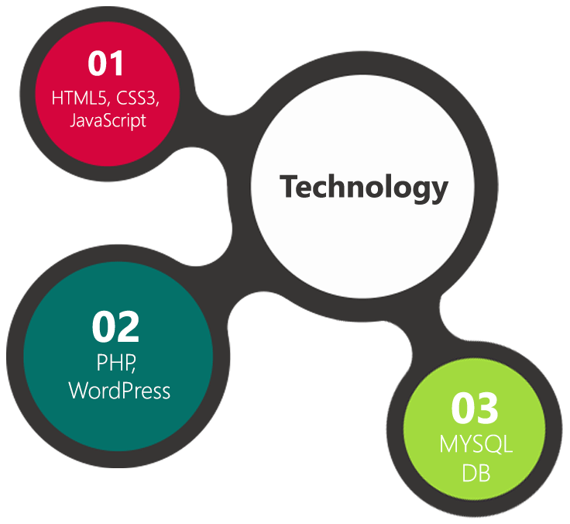
Technology Specifications
Technology Stack
Language : ASP.net or PHP
Database – My SQL or MSSQL
Server – Apache or IIS
Operating System – Linux or Windows
Server and Hosting
Cloud Hosting
HDD Quota – 50 GB
1 GB Backup Storage
25K Visit per month
128 Bit SSL

Slide 8
Project Timeline & Deliverables

Slide 9
Project Timeline & Deliverables
The time estimated for delivering the application is 19 working man days
Activity | Effort | Effort Total (Man Days)
Theme purchase, customization & running prototype | 12 | 49*
 | 10
Admin
Home page, Login | 1.5
Company, Human Resources, Information Technology, Resources, My contents & InFocus magazine | 15
Quality Analysis (QA), UAT, Support, Implementation & Go live | 10.5
Deliverables
Selection & Purchase of Template
Content upload
Fully developed and tested Website for deployment
* See Assumptions for exclusions

Slide 10
Commercials

Slide 11
Commercials
Website Development
Sl. | Description | Cost
01. | Development of ASP.Net / PHP based Website integrated with Yammer and Office365 | AED 0,000

Slide 12
Commercials
Hosting (Yearly ????)
Sl. | Description | Cost
01. | Hosting of the Application in Cloud Server including 50 GB Quota 10 GB Backup | AED 3,000

Slide 13
Assumptions & Out of Scope

Slide 14
Assumptions
Website shall be done using purchased Template. Verbat shall purchase the template agreed and signed off by the client
Client need to provide licensed images in specified size & format
Client will provide the branding guidelines
Client shall purchase the domain name
If client is providing the server for hosting, it shall adhere to the server & hosting specification
Estimate does not include
Form Submission
Book meeting room, Find staff, New employee induction
Leave application, Business trip advice, Expense claim, Passport release.
English will be the only language supported
PHP implementation will not support single sign on

Slide 15
Out of Scope
Any language other than English
Database migration
Physical deployment at client’s site
Backup solution and Disaster recovery for hosting
No Emails with the hosting
Content writing
Annual Maintenance Contract
Theme customization (Layout & Element Placements)

Slide 16
Terms & Conditions

Slide 17
Terms & Conditions
Offer Valid for 30 calendar days from the date of submission of the Proposal
An average of 20 working days are assumed in a month
This proposal and all technical/ functional specifications have been derived or concluded from the data shared via email / information's transferred during the initial requirement analysis meetings and conversations. Verbat reserves the right to amend the terms of this proposal, should the SOW terms, functional features and functionalities change during the course of the project
The website will be built as per the specifications agreed mutually. Any changes will be executed through a deﬁned change management process between both parties
All Source Code and other project artefacts would adhere to the Verbat document templates and internal coding standards
Acceptance criteria will be based on the clauses which were mutually discussed between Verbat and client at the Requirement Analysis phase and the same will be documented and approved by both parties through official emails
Final deployment to Live server pursuant to completion of all payments

Slide 18



Contact Us
217, Sheikh Rashid Bldg
P.O Box 56272, Dubai United Arab Emirates
+971 04 2973236
Lekshmi.krishna@verbat.com
USA 2033 Gateway Place
Suite 500
San Jose , CA- 95110
India
Level 3, PTC Tower
Nanthancode Trivandrum, Kerala

Slide 19

Thank You
© 2016. All Rights Reserved Verbanet Technologies LLC www.verbat.com

